Slide 1
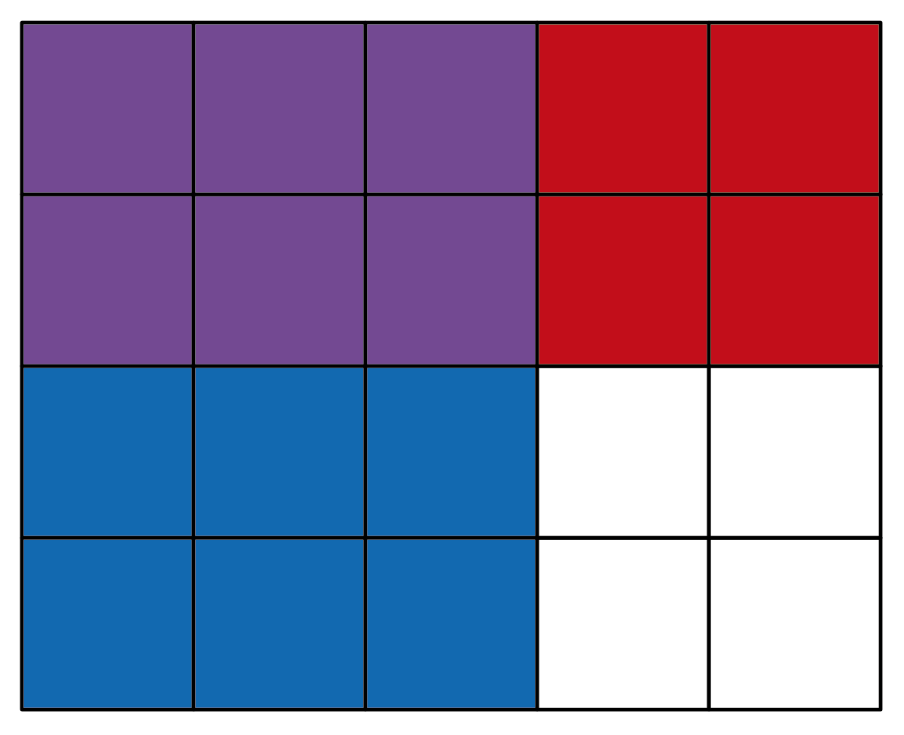
Explain the maths – Preview
Explain how the diagram shows that × =

Slide 2
Explain the maths
Explain how the diagram shows that × =
Hint: Look at the shading in the diagram.
Extension: How else could the answer be written?

Slide 3
Explain the maths
Answer:
The rectangle is divided into 5 columns and 3 are shaded.
The rectangle is divided into 4 rows and 2 are shaded.
There are 6 squares that are shaded twice, out of 20 altogether.
Extension answer: = = 0.3

