Slide 1
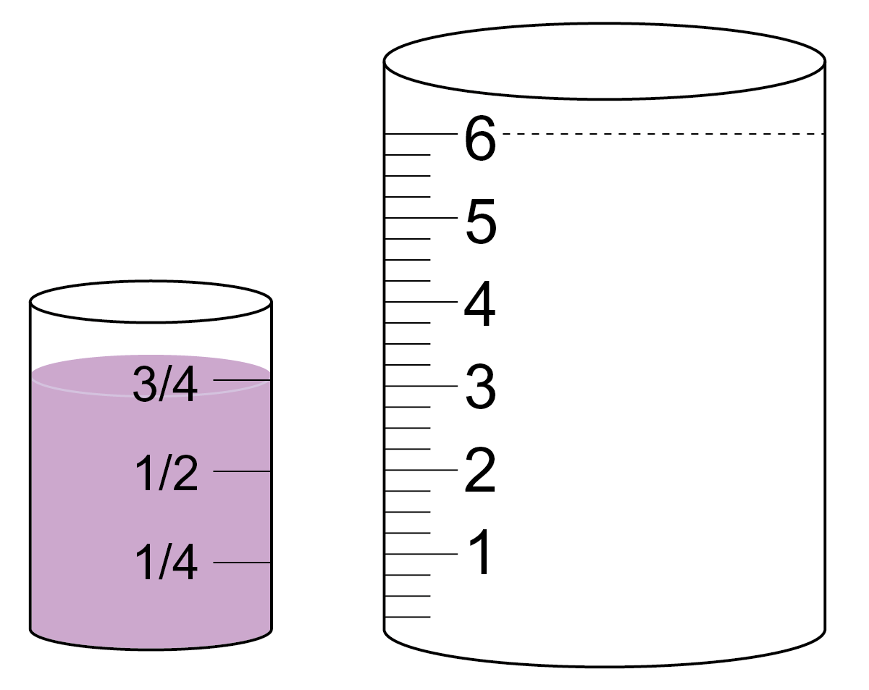
Fill it up – Preview
The small container holds litre.
The large container holds 6 litres.
How many times would the small container need to be emptied to fill up the large container?

Slide 2
Fill it up
The small container holds litre.
The large container holds 6 litres.
How many times would the small container need to be emptied to fill up the large container?
Hint: Use the markings on the large container to help.
Extension: Can you write this problem as a number calculation?

Slide 3
Fill it up
Answer: 8 times
Extension answer: 6 ÷ = 8

