Slide 1
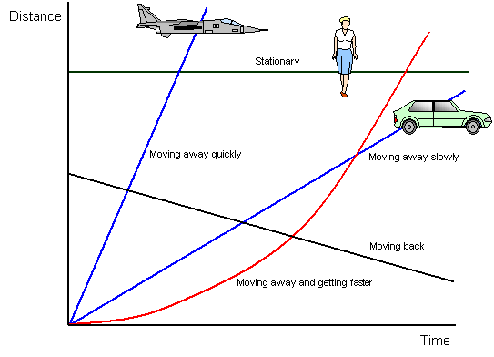
Plotting Straight Line Graphs

Slide 2
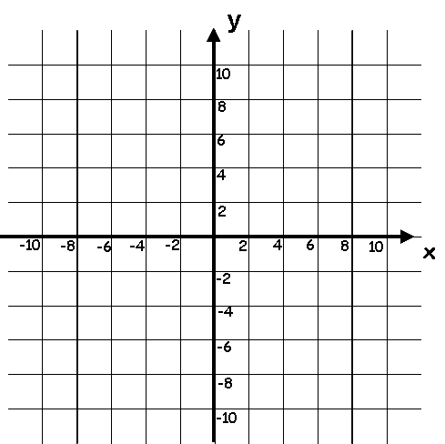
Starter
What is the equation of each line? Why?
Always refer to coordinates!
x = 8
y = x
y = 6
y = -3
y = -x
x = -6

Slide 3
Plotting Straight Line Graphs
Today we are going to look at plotting graphs on a set of axes
Any equation can be plotted in this way, and will have two features that define it
Its gradient, (steepness)
Where it crosses the y-axis (y-intercept)
You need to be able to recognise both of these features from an equation alone, or from a graph which is already drawn
Same gradient, different y-intercept
Same y-intercept, different gradient

Slide 4
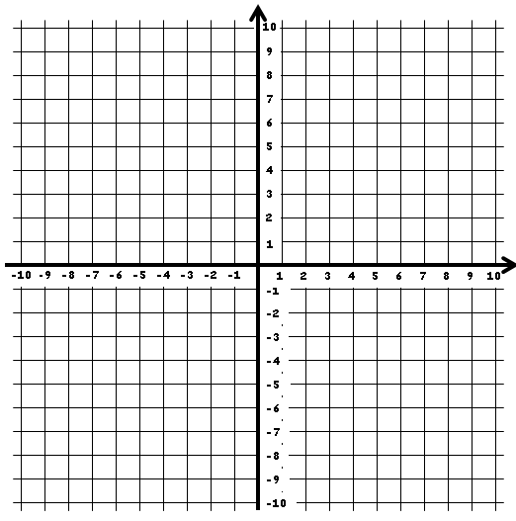
Plotting Straight Line Graphs
y
$$y=x+1$$
Plot a graph to show the equation:
$$y =x + 1$$
This graph will show the points on the grid where:
‘the y-coordinate is equal to the x-coordinate, plus 1’
→ The easiest way to find this set of points is to choose values for x and work out the value of y that goes with them
x
x
0
1
2
y
1
2
3

Slide 5
Plotting Straight Line Graphs
y
$$y=x+1$$
Plot a graph to show the equation:
$$y =x + 1$$
What is the gradient of the line?
Gradient is how steep the line is. You can think of it as:
‘If I go one unit across, how much do I need to go up or down to get back on the line?’
→ The gradient of this line is therefore 1
1 up
1 across
x
1 up
1 across

Slide 6
Plotting Straight Line Graphs
y
$$y=x+1$$
Plot a graph to show the equation:
$$y =x + 1$$
What is the y-intercept of the line?
The y-intercept is where the graph crosses the y axis
→ The y-intercept of this line is therefore 1
x

Slide 7
Plotting Straight Line Graphs
y
$$2x+y=7$$
Plot a graph to show the equation:
$$2x+y=7$$
This graph will show the points on the grid where:
‘2 times the x-coordinate, plus the y-coordinate, is equal to 7’
→ Choose values for x and work out the value of y that goes with them
x
x
0
1
2
y
7
5
3

Slide 8
Plotting Straight Line Graphs
y
$$2x+y=7$$
Plot a graph to show the equation:
$$2x+y=7$$
1 across
What is the gradient of the line?
Gradient is how steep the line is. You can think of it as:
‘If I go one unit across, how much do I need to go up or down to get back on the line?’
→ The gradient of this line is therefore -2
2 down
x
1 across
2 down

Slide 9
Plotting Straight Line Graphs
y
$$2x+y=7$$
Plot a graph to show the equation:
$$2x+y=7$$
What is the y-intercept of the line?
The y-intercept is where the graph crosses the y axis
→ The y-intercept of this line is therefore 7
x

Slide 10
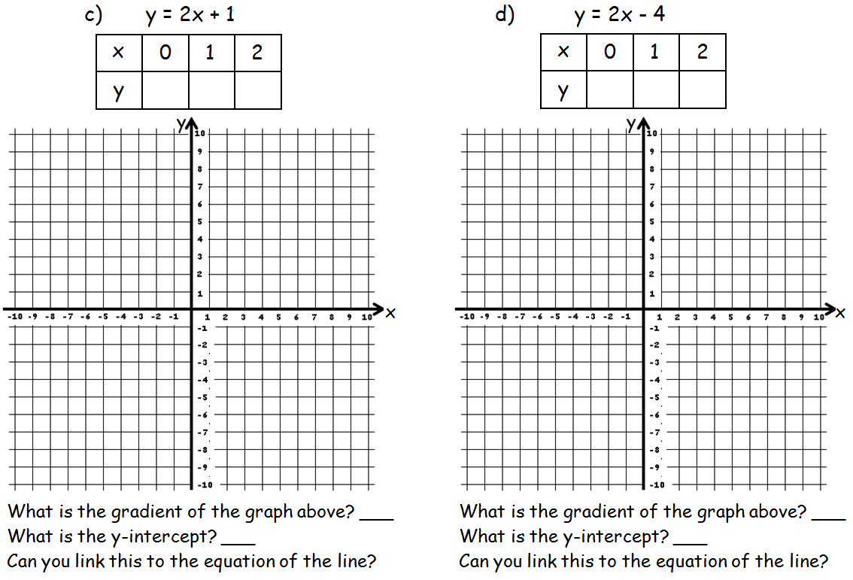
Plenary
1
3
5
-4
-2
0
2
2
1
-4

Slide 11
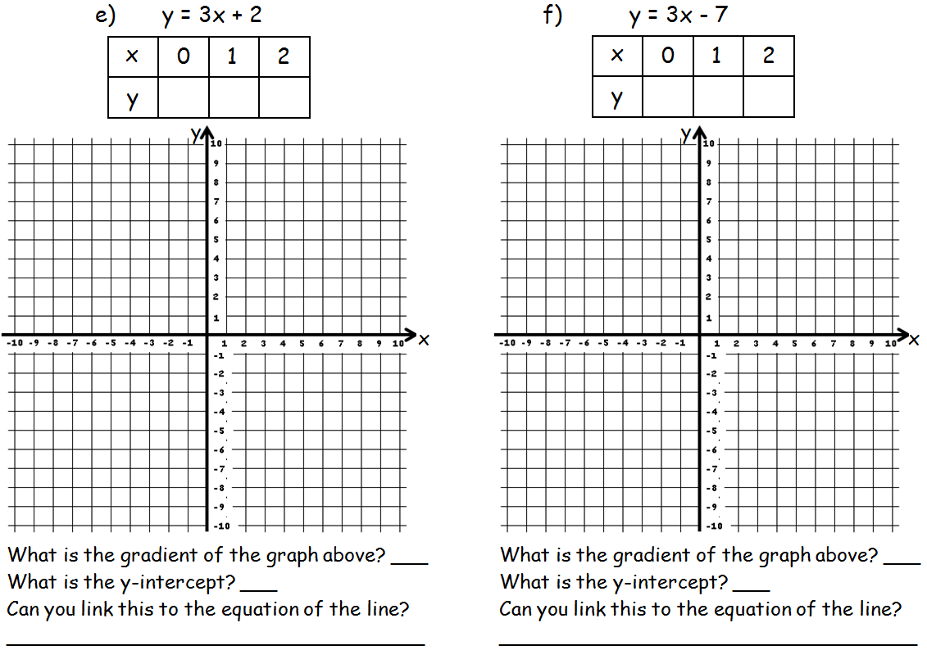
Plenary
2
5
8
-7
-4
-1
3
3
2
-7

Slide 12
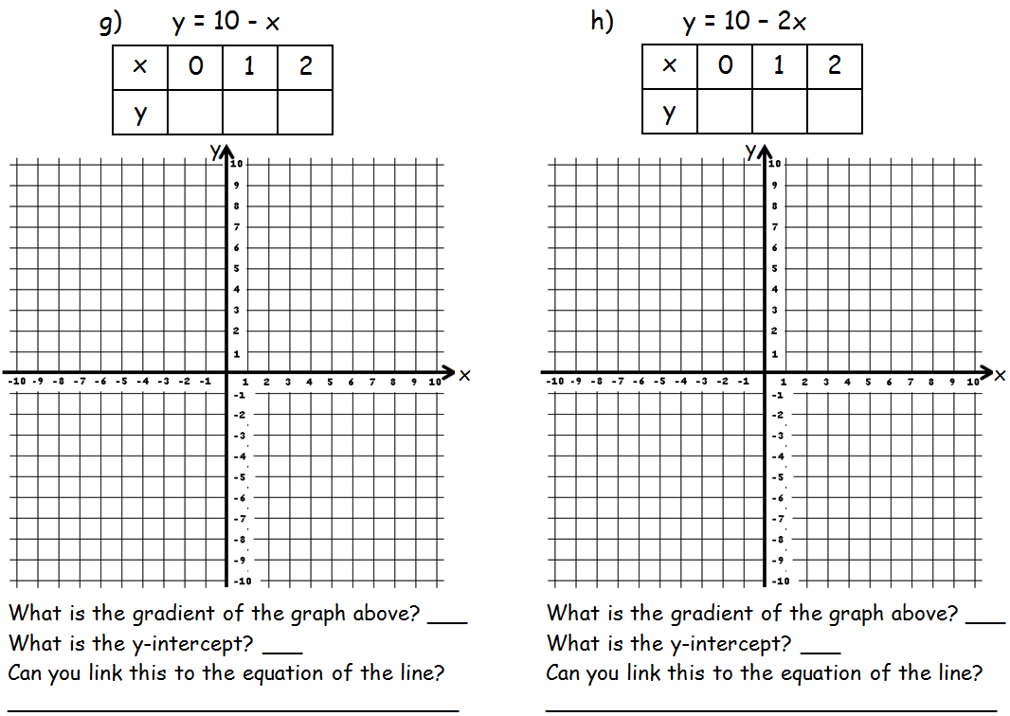
Plenary
10
9
8
10
8
6
-1
-2
10
10

Slide 13
Plenary

Slide 14
Summary
We have looked at plotting a straight line
We have seen how to check whether a co-ordinate is on a line
We have also looked at 2 equations on the same set of axes…

